Slide 1
Embracing the Cloud with
Spectra On-Prem Glacier Solutions
Spectra Logic Proprietary Information
10/16/23
Dave Fitch
Enterprise Sales Rep
davef@spectralogic.com
217-553-8001
Juan Valcarcel
Solutions Architect

Slide 2
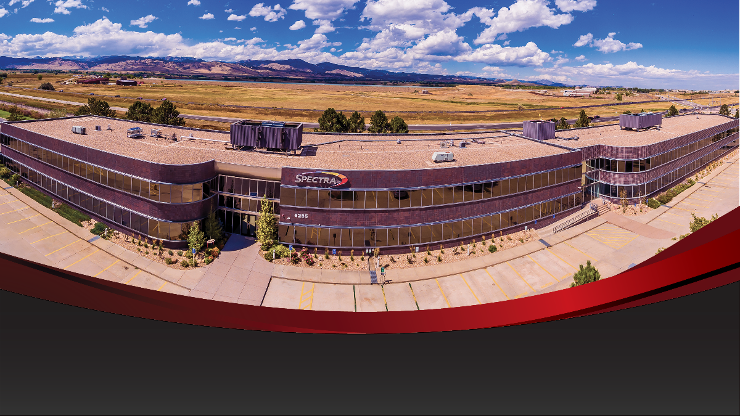
All design, engineering, and support is in Boulder, CO

Slide 3
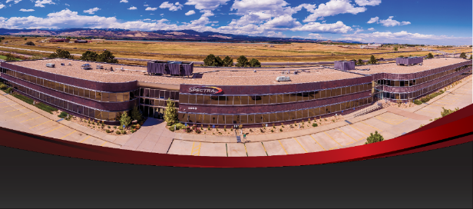
Spectra provides stability and consistency:
43 year old company, privately held
Focus on data storage and management
125 Patents issued (and more pending)
Consistent profitability
100% debt-free
450 Employees in 10 countries
Design, Engineering, & Support all in Boulder, CO
History of innovation in secondary storage
  NAS, Object Storage, Tape, Hybrid Cloud
Notes:
SNIA: Storage Industry Networking Association

Slide 4
Whiteboard Presentation Summary
Research institutions have a variety of storage on which data typically resides including:
  NAS, SAN, Servers, USB drives, Instruments, Lustre, GPFS, Object storage
To properly archive data to lower cost tiers of storage and free up space on the production tier, it requires a:
  Front end policy engine to decide what to move and when – by scanning CIFS or NFS shares
  Back-end policy engine to decide where it goes – What storage mediums is it stored on, how many copies are made, how long does it live on each tier, what’s the long-term migration strategy?
Data can be moved to any combination of archive targets depending on the need of data set
  Spinning disk, spin down disk, tape, cloud, or a geographically diverse location
  Your “Bucket Policies” determine what combination of targets are used
  These tiers truly imitate AWS Instant Retrieval, Flexible Retrieval and Deep archive but with quicker access & lower cost
The original files are replaced with either a symlink (if moved to disk) or an html file (if moved to tape or cloud – using a restful interface so it doesn’t time out)
Files can be easily found and restored, or apps can easily be integrated so that PB’s of data appear to be accessible directly from the app.
Data can also be ingested into the archive policy engine via CLI, S3, Globus or about 30 other data mgt apps that have a direct integration
Spectra Logic can provide the front-end policy engine (StorCycle), back-end policy engine (Black Pearl), spinning or spin-down disk (on Black Pearl), tape archive and the complete solution except for the cloud storage itself.

Slide 5
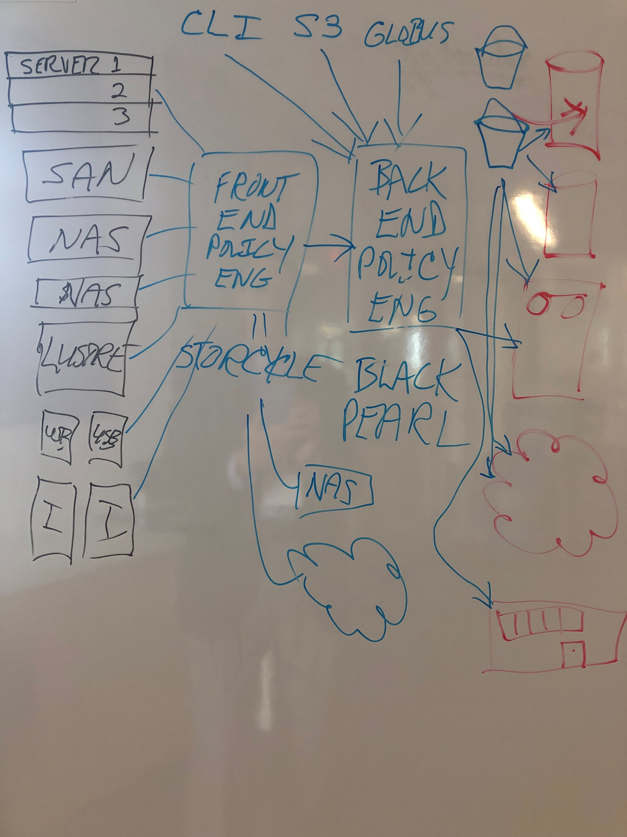
Actual Whiteboard from the CCS Summit

Slide 6
Challenge: Data Storage is Growing Exponentially
42%
Growth
Globally, the average enterprise organization saw data increase 42% over the last two years.
97%
Unused
97% percent of data
goes unused and may not be able to be deleted.
68%
Cost Concern
68% of companies report storage costs as their top concern with data storage.
42 https://www.statista.com/statistics/1186304/total-enterprise-data-volume-location/#:~:text=From%202020%20to%202022%2C%20the,growth%20over%20these%20two%20years.
68% - https://www.lightedge.com/blog/the-data-explosion-and-hidden-data-storage-costs-in-the-cloud-could-object-storage-be-the-
ps://www.lightedge.com/blog/the-data-explosion-and-hidden-data-storage-costs-in-the-cloud-could-objentially%20rise
97 https://www.replicon.com/blog/what-does-it-take-to-become-a-data-driven-organization/

Slide 7

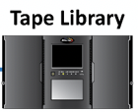
Spectra’s Simple Portfolio
Standalone Software
Platform
Storage
NAS
Vail
Multi-Cloud Data Management Software
StorCycle
Digital Archive Software for Data at Scale
S3 Standard Disk
RioBroker
Data movement Software for Media & Entertainment
S3 Infrequent Access/Glacier Instant Retrieval Disk
Vail Software
BlackPearl
On-prem Glacier

Slide 8







Amazon Cloud Glacier vs. Spectra On-Prem Glacier
Amazon S3 Glacier Instant Retrieval
storage class
Milliseconds retrieval of data in a low-cost S3 storage class
Amazon S3 Glacier Flexible Retrieval storage class
Minutes to 12 hours retrieval of data in a lower cost archive S3 storage class
Amazon S3 Glacier
Deep Archive
storage class
12 to 48 hours retrieval of data in the lowest cost archive S3 storage class
Amazon S3 Glacier 100% cloud accessed and retrieved
Expect costs for bandwidth and egress fees
Milliseconds
vs.
Milliseconds
Minutes to 12 Hours
vs.
Seconds
12 to 48 Hours
vs.
Minutes
Instant Retrieval
storage class
MILLISECONDS retrieval of data in a low-cost S3
storage class
Scale: up to 20PB
Eco Object
storage class
Retrieval of data in SECONDS with spin-down disk for reduced carbon footprint
Scale: up to 20PB
Archive
storage class
Retrieval of data in MINUTES the lowest cost & most environmentally positive solution
Scale: up to 100s of PBs
Spectra On-Prem Glacier
On-premises storage with hybrid cloud option
No additional fees
Notes:
AWS set the stage / Glacier requires “staging”

Slide 9


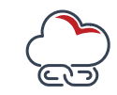
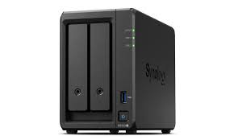
A Set of Workflows for Universities (applicable to many situations)
Engineering
Comp Sci
Physics
Business
How do we move to on-prem managed services vs individual deployments?
IT Dept.
The Traditional approach…
  Every Department buys their own storage
  When it fills, they blindly buy more
  Some departments invest in archive (traditionally HPC)
  Some department buy USB or consumer grade boxes that get “lost”
  Some use the cloud
  Everyone absolutely has to have their own unique backup solution
IT attempts to centralize but…
  User experiences are difficult to change
  Data management is painful
  Everyone wants to game the system - and some don’t want to comply
  Everyone wants only file systems
Notes:
Some try to use the cloud (and either get big bills, delayed bills, or inadequate access when used improperly)
IT attempts to centralize but
User experiences are difficult to change
Data management is painful
Everyone wants to game the system - and some don’t want to comply
Everyone wants only file systems

Slide 10
A Better Platform for a Diverse Set of Workflows
Engineering
Comp Sci
Physics
Business
IT

Slide 11
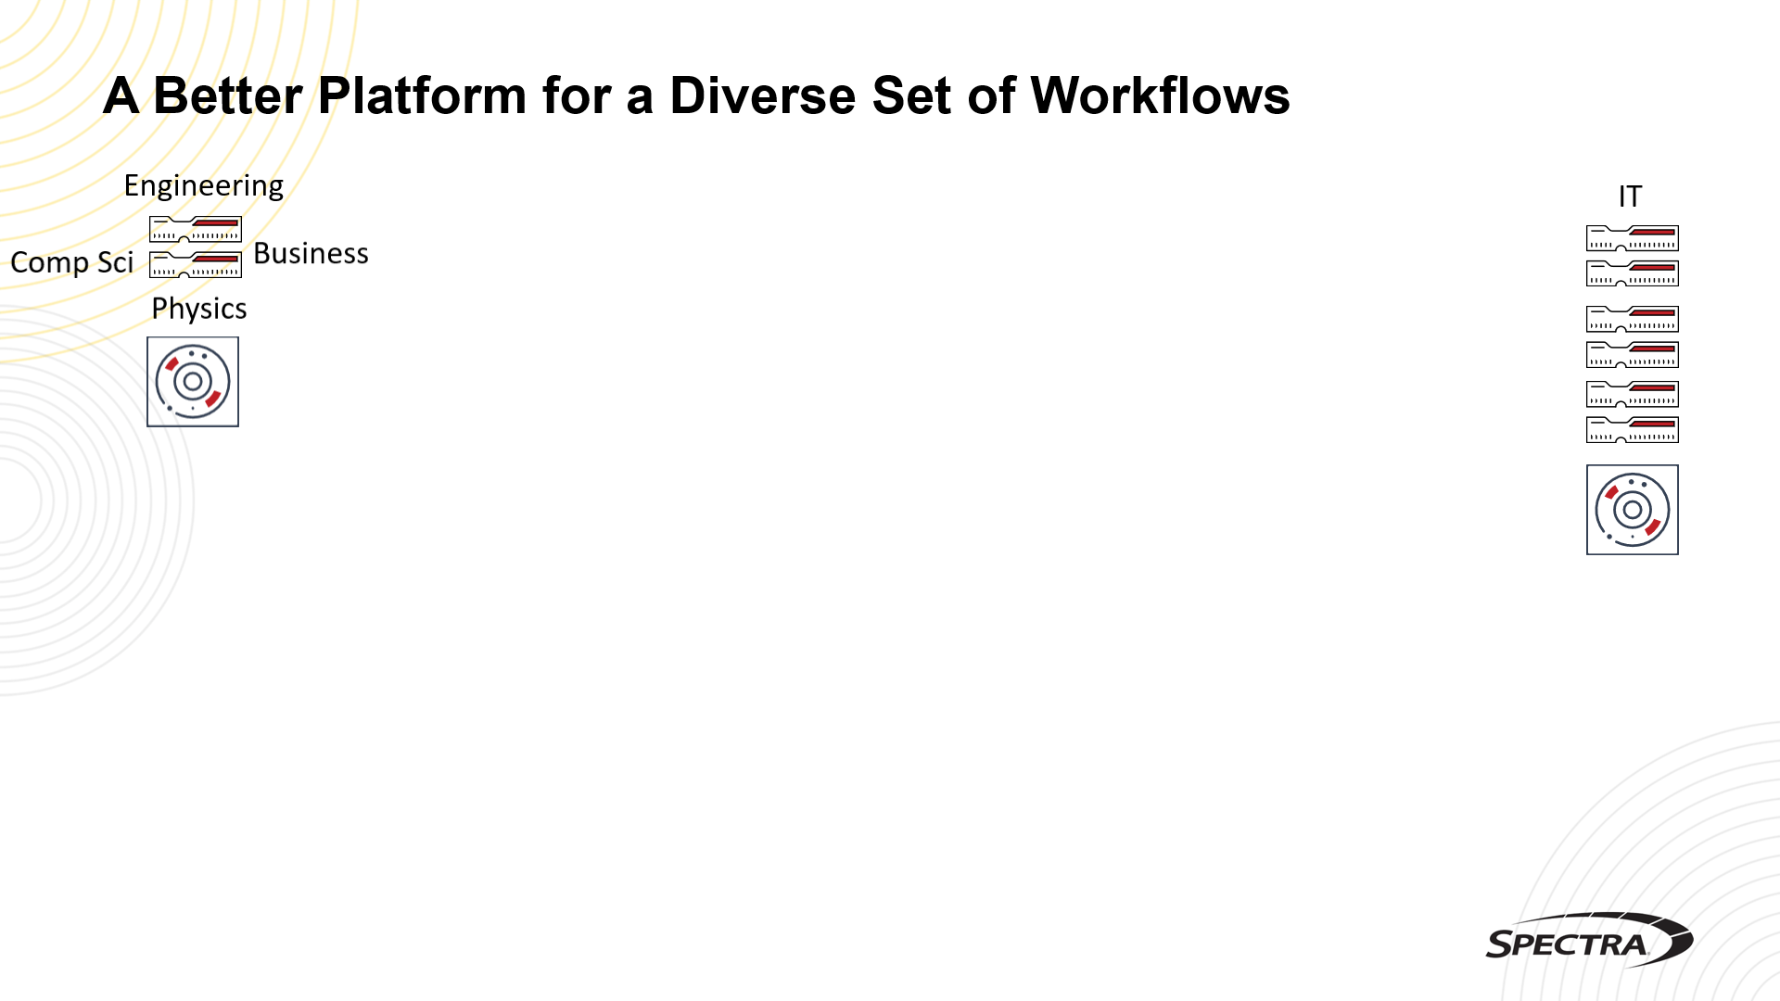
StorCycle
Automated Tiering & Archive
Rio
Media Archive
Vail
Consolidated Backup
Vail
S3 Storage Target
Vail
Glacier
On-Prem Glacier

Slide 12
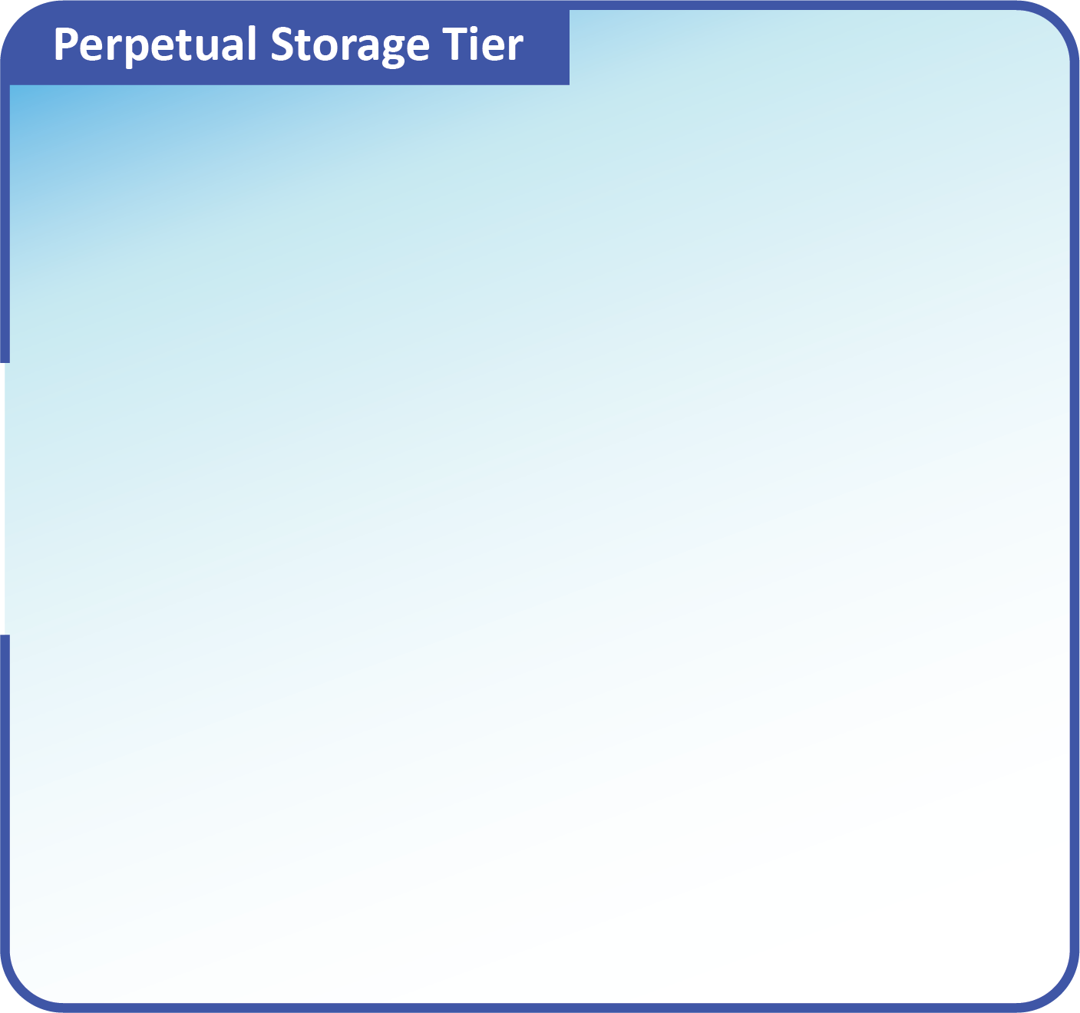

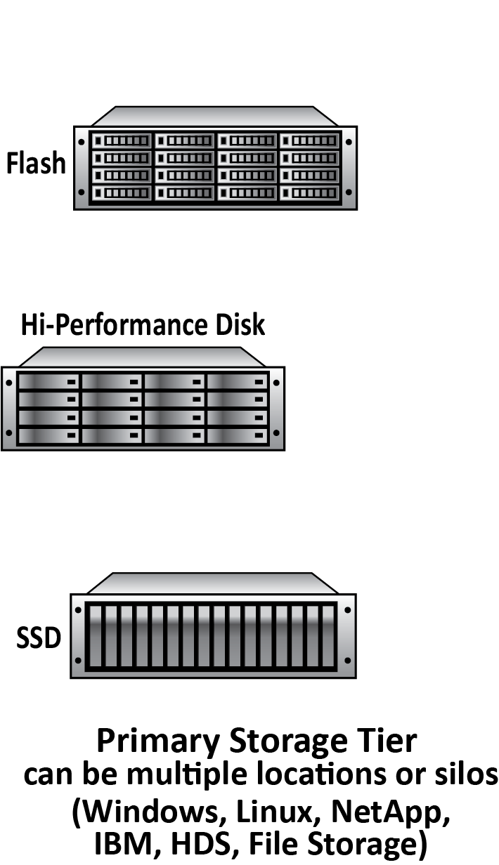
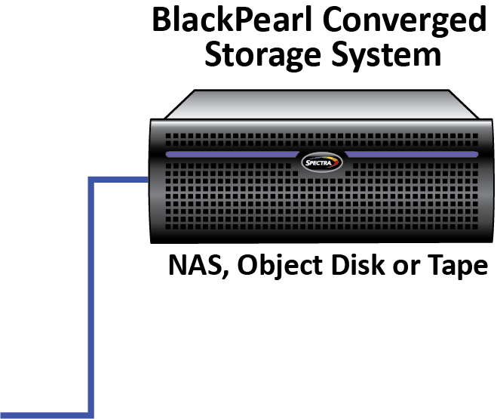
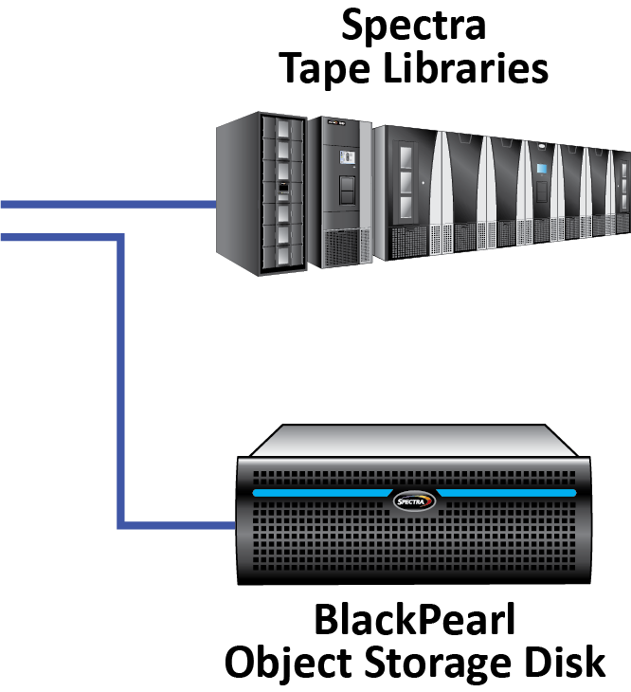
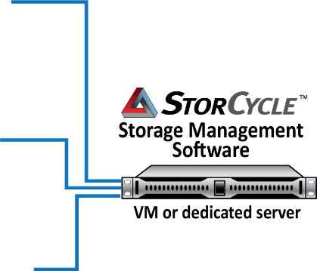
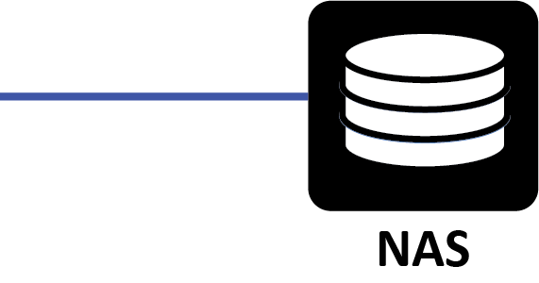
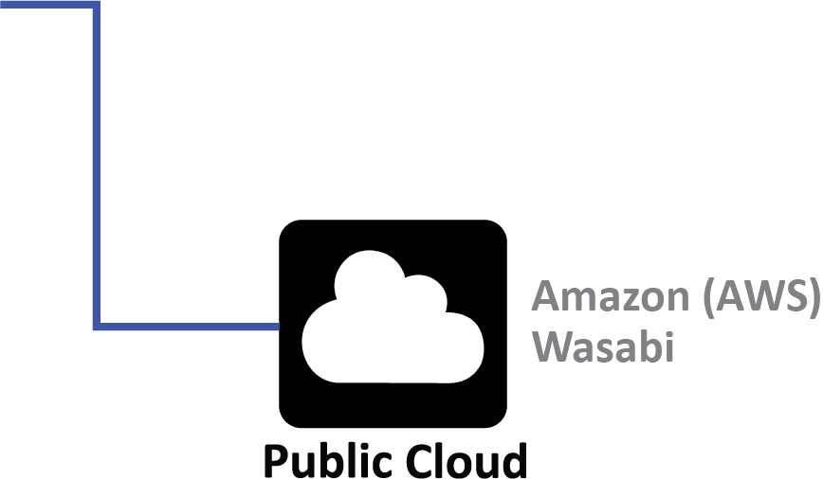
StorCycle Basic Architecture

Slide 13
Why Object Storage (S3)
Top 4 Reasons to Use On-Prem Glacier
Scalability
Protection - Ransomware
Protection - Multi-copies
Sharing - Multi-Site
Sharing - Multi-Node
Cost - Simple, multi-copy
Greater ROI versus the public cloud
  One cost vs forever, Egress
  Glacier Disk (Spin Down)
  Glacier Tape - Long term preservation
Ransomware resiliency
  Disaster recovery, Object Locking, Access
Data sovereignty
  Flexibility - Cloud Lock-in - ownership
  Cloud Now or Later
Data governance

Slide 14





On-Prem and Cloud Collaboration
Sharing
Simple open source systems like OwnCloud allow on prem mass collaboration with an S3 backend
Full cloud collaboration out-of-data-path
File vs Object
OwnCloud, MountainDuck, StorCycle bridge the gap as users adapt to new workflows
Scalability
Spectra partnership with Arcitecta allows seamless scalability of primary storage to hundreds of PB, HA, and single namespace locally
Multi-site replication
Consider using the existing tape as an alternate DR storage location
BlackPearl S3 can present the library as a Glacier target
Quotas and tracking
Simple bucket tracking allows real time chargeback scripting using BlackPearl
Roadmap includes full quota management system
Cloud now or later
Spectra data management allows seamless migration, hybrid collaboration, or full moves to or between clouds. Use the cloud judiciously and prepare for change

Slide 15
Questions?
Contact Dave Fitch
217-553-8001
davef@spectralogic.com

