Slide 1
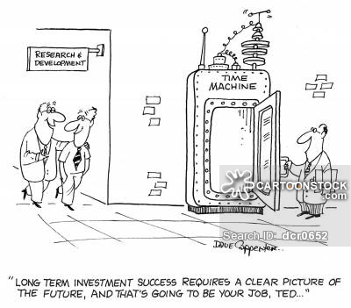
Poster Title
Student Name, Department, University
Research Category
  Big Data/Big Computing/etc…
Description of Research
  This project will determine the future of all research activities…end world hunger and bring peace to all!
Compelling graphic/visualization
2nd Annual Commonwealth Computational Summit – October 23, 2018

